Slide 1





WIRED 2024
MNE-Python Tutorial
March 13, 2024
9:30am – 12:30pm
Paris, France
Maansi Desai, PhD
Postdoctoral Fellow
UT Austin
Alexandre Gramfort, PhD
Senior Research Scientist
Meta Inc.
Apolline Mellot
PhD Candidate
Univ. Paris-Saclay

Slide 2
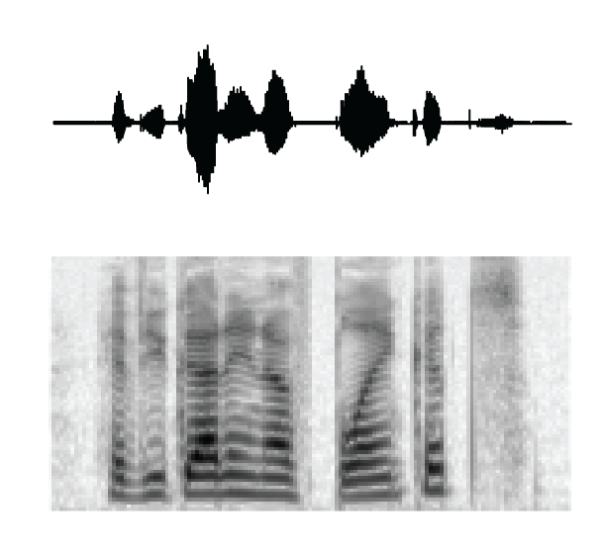
sentence
Have you got enough blankets?
meaning
word
hɪv y gɑɾ ɪn ʌf blæŋ kᵼts
syllable
hɪvygɑɾɪnʌfblæŋkᵼts
phoneme
spectrotemporal
(frequency decomposition)
acoustic vibration
Notes:
Study speech and language. And how we convert language on the level of acoustic vibrations into spectrotemporal, phoneme, syllable, word, meaning.
And we will be using some data from our lab

Slide 3
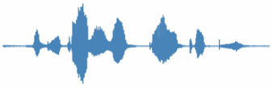
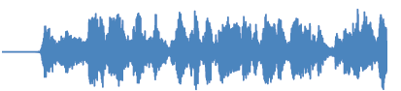
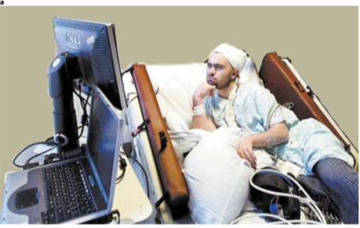
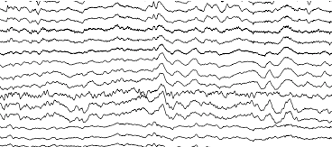
INTRACRANIAL RECORDINGS IN THE HOSPITAL
Miller Nature Human Behavior 2019
Intracranial recordings + cognitive tasks for research
WIRED 2024
Notes:
Recordings taken from inside the brain – treatment for drug resistant epilepsy
Seizures that interfere with daily lives. Tried meds but meds don’t work or can’t control epilepsy with other methods
We can ask patients if they want to participant in tasks. Watching things on screen, listening to different sounds. Need activity from specific brain areas.

Slide 4
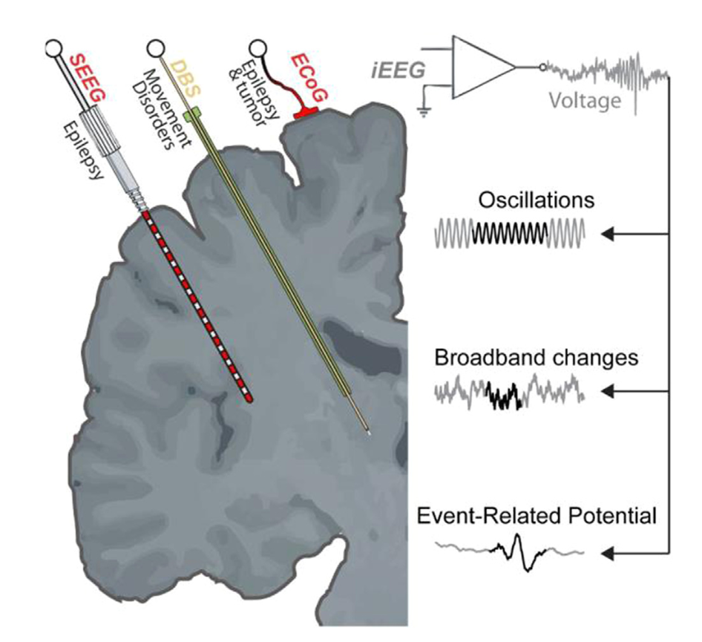
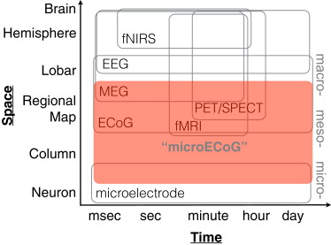
HOW DO SIGNALS DIFFER?
Chang et al. Neuron 2015
Mercier et al. NeuroImage 2022
WIRED 2024
Notes:
Signals are different form other methods you’re more familiar with. Have high spatial and temoporal resoluation.
On right – look at ECoG (one name for type of intracranial recoring) – have millisecond resolution and millimeter res for spatial compared to fMRI
Senesor places on brain – clinically determined.
If you’re looking for open science datasets – they are not going to have exactly same converage or voxel space as fMRI
Recording LFPs – voltages that respresent post synaptic potentisl from neurons in the brain – gives you more spatially specifc info compared to EEG.

Slide 5
HIGH GAMMA AS AN INDEX OF NEURAL ACTIVITY
”It had gone like clockwork”
Stimuli from TIMIT
(Garfolo et al. 1993)
“high
gamma”
correlated with multi-unit spiking
(Ray & Maunsell, PLoS Biology 2011)
WIRED 2024
Notes:
One of the things I will show yo uhow to do today is to extract the high gamma analytic amplitude of the nrual signal
If youre working with Ephys, you might know about time frequency analysis or lookinga t osccilations at different frequency bands.
So we take ossciatlions and decompose into frequency bands. And we have found in previous work that there is neural data in the band between 70-150 Hz (depends on lab) – this is associated with time locked responses to external stimuli. We call this high gamma as opposed to 30-70 which is regular gamma.
So we see increased power in red here – correlated with acoustic information when someone is listening to sentence – have localizaed information.

Slide 6
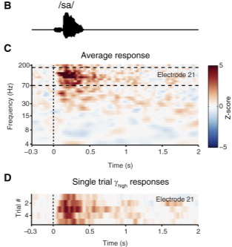
ADVANTAGES OF INTRACRANIAL RECORDINGS
Can measure changes at fast timescales
Phonological information: /b/ vs. /p/
You know where your signals are coming from
Very high SNR, requires fewer trials than EEG/MEG
WIRED 2024
Notes:
Can measure fast time scales – measure change sin phonetic infor
Know where your signals are coming from
High SNR compared to EEG and MEG
Figs showing high gamma band responses to a single syllable – and we see that with even very trials like 5 trials, we get responses in short # of trials

Slide 7
DISADVANTAGES OF INTRACRANIAL RECORDINGS
Coverage depends on clinical need, not your research question
Invasive (must be done in patient populations)
Epilepsy/tumor
Relatively time-limited experiments / less controlled experiments
WIRED 2024
Notes:
- covereage not the same – can’t relaly do group level nalaysis unless you think about difference in where elcs are across people
- invasive – only done in patient populations. How epilepsy may affect data?
- time limited when working with clinical populations (in patient in the hospital). You have to do work around clinical team and making sure that takes priority. Datasets take a lot of time and effort

Slide 8
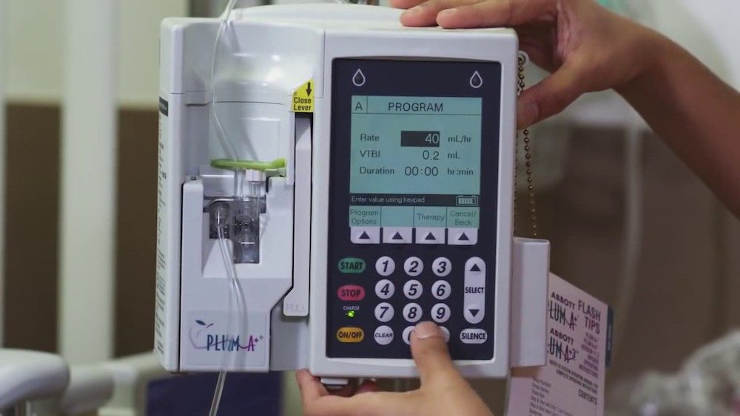
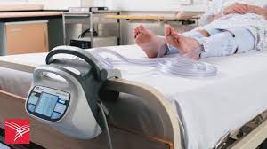
CONSIDERATIONS WHEN PREPROCESSING iEEG DATA
Environment is not as controlled as a typical recording environment (sound proof booth)
Background sounds
Where electrodes are located
How electrodes are plugged into amplifier is important for (re)-referencing
Sources of electrical noise
Acquisition sampling rate is important if you want high frequency information
WIRED 2024
Notes:
Going to talk about considerations when preprocessing iEEG. Open datasets may have preprocessed for you so you may not have to worry about tha tbut if you have your own data,
- environment is not as controlled
Where the electrodes are located
May be different types of electrical noise may affect quality of data
And also knowing your sampling rate is important and I will show how to look at this

Slide 9
DIFFERENT TYPES OF iEEG ARTIFACTS
Motion artifact
Epileptiform activity
Chewing/jaw artifact
VNS artifact (vagus nerve stimulator)
WIRED 2024
Notes:
VNS – some people have this. Recently, we had this very strange 20 Hz noise. And it turned out it was this VNS stimuliator and we’ll go through what this looks like in the datasets I provided for this workshop.

Slide 10
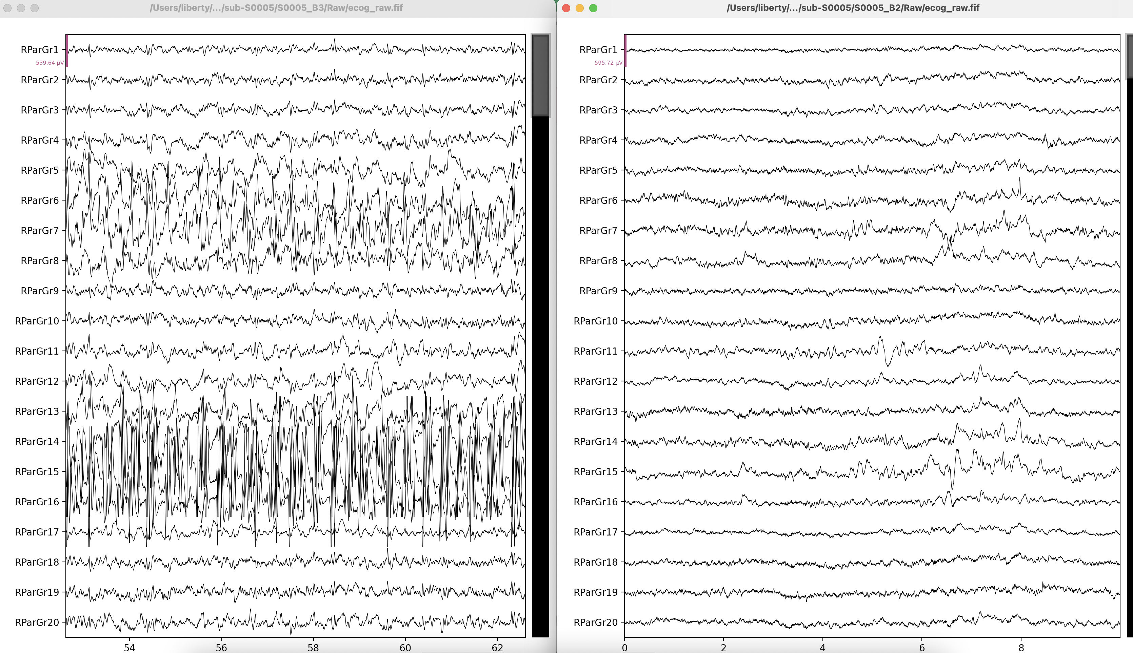
SEIZURE ACTIVITY (LEFT)
WIRED 2024
Notes:
Different recording time blocks
Example of artifact – looks like epilepsy. Fast wave followed by slow wave. You might see this in iEEG datasets. Same participant in two different sessions – one session synchronized actibvity that isn’t in the other session
Wwant to exit out of this and go to turorial

Slide 11
iEEG TUTORIAL
We will load iEEG data with BIDS metadata
Plot power spectrum
Plot raw data and look for bad channels and artifacts
Convert to high-gamma analytic amplitude
Plot evoked data
WIRED 2024

